Slide 1
Artificial Neural Networks (ANNs)
&
Machine Learning
Dr. Lan Nguyen
Dec 13, 2018
Presented to IEEE ComSig, Orange, CA

Slide 2
Introduction to Neural Networks
Neural Network (NN) is part of the nervous systems, containing a large number of neurons (nerve cells) where network denotes connections between these cells, a graph-like structure
Artificial Neural Networks (ANNs) refer to computing systems whose central theme is to borrowing from the biological neural networks
  Also referred as “neural nets,” “artificial neural systems,” “parallel distributed processing,” etc.

Slide 3
Motivation
Why Artificial Neural Networks (ANNs)?
  Many tasks involving intelligence are extremely difficult to automate, but can be done easily (effortless) by animals e.g. recognize various objects and make sense out of large amount of visual information in their surrounding
  Tasks involve approximate, similarity, common sense reasoning e.g. driving, playing piano, etc.
  These tasks are often ill-defined, experience based, and hard to apply logic
This necessitates the study of cognition i.e. the study and simulation of Neural Networks

Slide 4
What is ANN?
Conventional computers can do just about everything…
ANN is a novel computer architecture and algorithm relative to conventional computers
It allows very simple computational operations (additions, multiplications, and logic elements) to solve complex, ill-defined mathematical problems, non-linear, and stochastic problems
A conventional algorithm will employ a set of complex equations and only will apply to that problem exactly to it
ANN will be computationally and algorithmically simple and it will have self-organizing features to handle a wide range of problems.

Slide 5
Biological Neural Activity
Neural activities passes from one neuron to another neuron in terms of electrical from body down to axon by means of electro chemical process
Axon acts as connection wire
Each neuron has a body, an axon, and many dendrites
  Neuron’s nucleus is where the neural computation takes place
  Can be in 2 states: firing and rest
  Neuron fires if incoming stimulus exceeds the threshold
Synapse: Thin gap between axon of one neuron and dendrites of another one
  Signal exchange

Slide 6
Biological Neural Activity
Synaptic Junction
Interconnection of Biological Neural Nets

Slide 7







Analog Representations
dendrites
Axon
$$w_{1}$$
$$w_{1}$$
$$w_{2}$$
.
Neural
Cell
.
.
Outputs
.
$$w_{i1}$$
$$w_{n}$$
.
.
.
Cell
i
.
$$w_{i}=weights$$
$$w_{in}$$
Schematic Analog of a Biological Neural Cell
Cell
i+1
$$w_{i+1}$$
Schematic Analog of a Biological Neural Network

Slide 8
Artificial vs Biological NN
Artificial NN
  Nodes
    Input
    Output
    Activation/Node function
  Connections
    Connection strength
Biological NN
  Cell body
    Signal from other neurons
    Firing frequency
    Firing mechanism
  Synapses
    Synaptic strength.
Highly parallel, simple local computation at the neuron level, achieve global results as emerging property of the interaction at the network level
Pattern directed (meaning of individual nodes only in the context of a pattern)
Fault-tolerant/graceful degrading
Learning/adaptation plays an important role

Slide 9
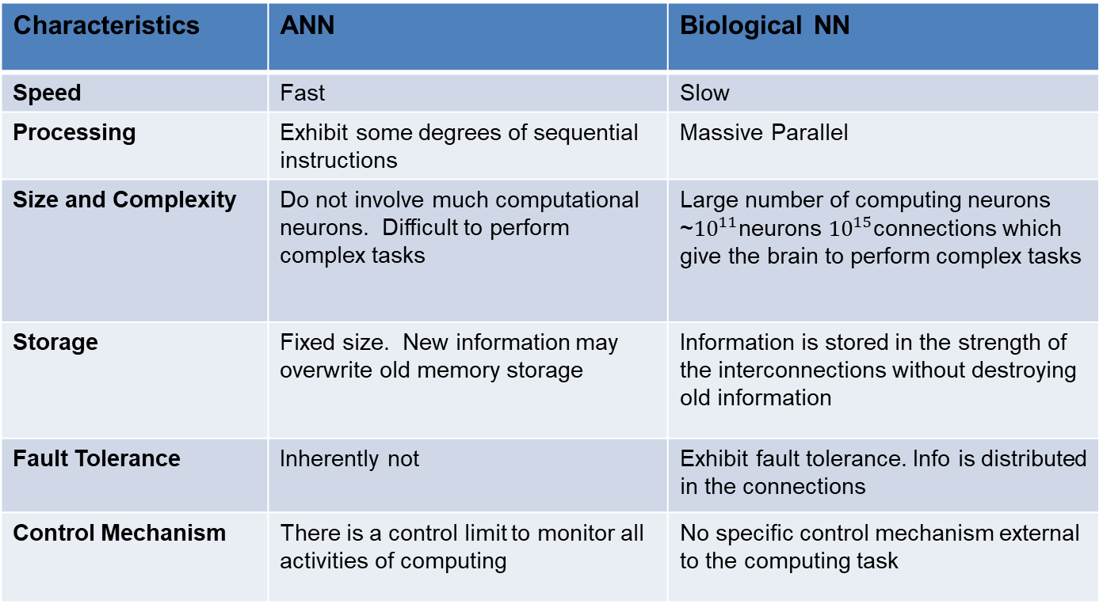
Artificial vs Biological NN
Characteristics | ANN | Biological NN
Speed | Fast | Slow
Processing | Exhibit some degrees of sequential instructions | Massive Parallel
Size and Complexity | Do not involve much computational neurons. Difficult to perform complex tasks | Large number of computing neurons ~${10}^{11}$neurons ${10}^{15}$connections which give the brain to perform complex tasks
Storage | Fixed size. New information may overwrite old memory storage | Information is stored in the strength of the interconnections without destroying old information
Fault Tolerance | Inherently not | Exhibit fault tolerance. Info is distributed in the connections
Control Mechanism | There is a control limit to monitor all activities of computing | No specific control mechanism external to the computing task

Slide 10
Abridged History of ANN
McCulloch and Pitts (1943)
  First mathematical model for biological neurons using simple binary functions. This model has been modified and widely applied in subsequent work
Landahl, McCulloch, and Pitts (1943)
  All Boolean operations can be implemented by McCulloch and Pitt model (with different threshold and excitatory/inhibitory connections)
Hebb (1949)
  Hebbian rule of learning: increase the connection strength between neurons i and j whenever both i and j are activated
  Or increase the connection strength between nodes i and j whenever both nodes are simulated ON or OFF

Slide 11
Abridged History of ANN
Early booming (50’s to early 60’s)
  Rosenblatt (1958)
    Perceptron: network of threshold nodes for pattern classification
    Perceptron learning rule
    Perceptron convergence theorem: Every thing that can be represented by a perceptron can be learned
  Widrow and Hoff (1960, 1962)
    Learning rule based on gradient descent
  Minsky’s attempt to build a general purpose machine with Pitts/McCulloch units

Slide 12
Abridged History of ANN
The setback (mid 60’s to late 70’s)
  Serious problems with perceptron model (Minsky’s book 1969)
    Single layer perceptrons cannot represent/learn a simple function such as XOR
    Multi-layer of non-linear units may have greater power but there is no learning rule for such nets
    Scaling problem: connection weights may grow infinitely
    The first two problems overcame in 80’s but the scaling problem remains
  Death of Rosenblatt (1964)

Slide 13
Abridged History of ANN
Renewed enthusiasm and flourish (80’s to present)
  New techniques
    Backpropagation learning for multi-layer feed forward nets (with non-linear, differentiable node functions)
    Thermodynamic models (Hopfield net, Boltzmann machine, etc.)
    Unsupervised learning
  Impressive applications: character recognition, speech recognition, text-to-speech transformation, process control, associative memory etc.
  Traditional approaches face difficult challenges
Caution:
  Do not underestimate difficulties and limitations
  Pose more challenges than solutions

Slide 14
Principles and Model of ANN

Slide 15
Principles of ANN
First formulated by McCulloch and Pitts (1943) by 5 assumptions
  Activity of a neuron (ANN) is all-or-nothing
  # excited synapses > 1 within a given interval for a neuron to be excited
  The only significant delay within the neural system is the synaptic delay
  Inhibitor synapse prevents the excitation of a neuron
  The structure of the interconnection does not change over time
By assumption 1, the neuron is a binary element
Hebbian rule (1949)

Slide 16
Principles of ANN
Associative Memory (AM) Principle [Longuett, Higgins, 1968]
  Information vector (pattern, code) that is input into a group of neurons may (over repeated application of such input vectors) modify the weights at the input of that certain neuron in an array of neurons to which it is input, such that they more closely approximate the coded input
Winner Take All (WTA) Principle [Kohonen, 1984]
  If an array of N neurons receiving the same input vector, then only 1 neuron will fire. This neuron being the one whose weight best fit the given input vector
  This principle saves firing from a multiple of neurons when only one can do the job

Slide 17
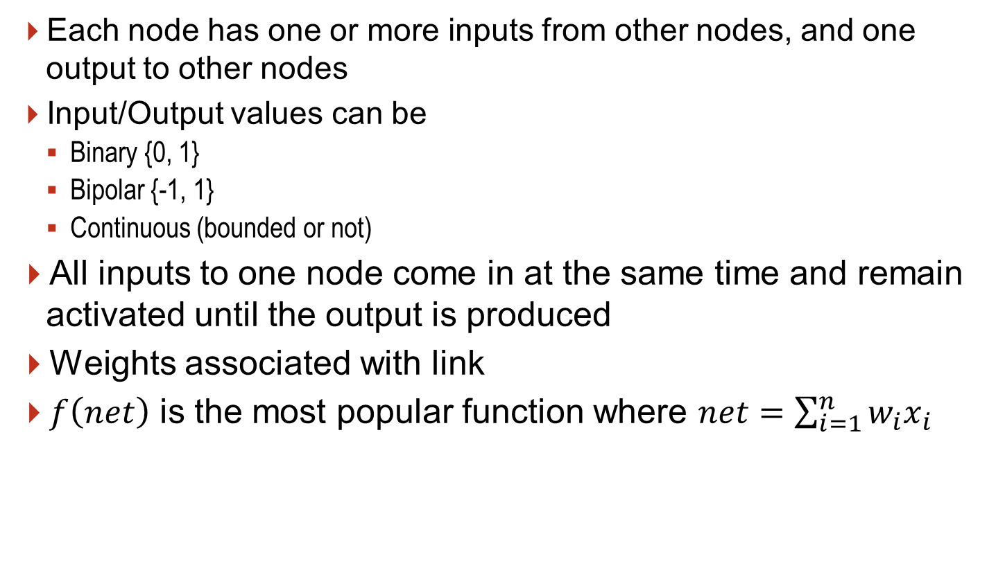
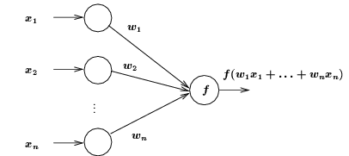
ANN Model
Each node has one or more inputs from other nodes, and one output to other nodes
Input/Output values can be
  Binary {0, 1}
  Bipolar {-1, 1}
  Continuous (bounded or not)
All inputs to one node come in at the same time and remain activated until the output is produced
Weights associated with link
$f\left(net\right)$ is the most popular function where $net=\sum_{i=1}^{n}{w_{i}x_{i}}$

Slide 18
Single Input ANN Model
Single Input

Slide 19
Multiple Inputs ANN Model
Multiple Inputs

Slide 20
Network Architectures

Slide 21
Multi-Layer Network Architectures
Four major multi-layer network architectures:
  The Back-Propagation Network [Rumelhart et al, 1986]
      A multi-layer Perceptron based ANN
      Provide an elegant solution to hidden layers learning
  The Hopfield Network [Hopfield, 1982]
      Feedback between neurons
      Weight adjustment is based on Associate Memory
  The Counter Propagation Network [Hecht-Nielsen, 1987]
      Self Organizing Mapping (SOM) is employed to facilitate unsupervised learning
      Winner Take All (WTA) principle
  The LAMSTAR (Large Memory Storage and Retrieval) Network
      A Hebbian network that use SOM layer and WTA principle
Other networks: Adaptive Resonance Theory (ART), Cognitron, Statistical Training, Recurrent Networks, etc.

Slide 22
Multilayer Network Architecture

Slide 23
Classes
Acyclic Networks
  Connections do not form directed cycles
  Multi-layered feedforward nets are acyclic
Recurrent Networks
  Nets with directed cycles (feedback)
  Much harder to analyze than acyclic nets
  Long short-term memory (LSTM)
Modular nets
  Consist of several modules, each of which is itself a neural net for a particular sub-problem
  Sparse connections between modules

Slide 24
Recurrent Network Architecture

Slide 25
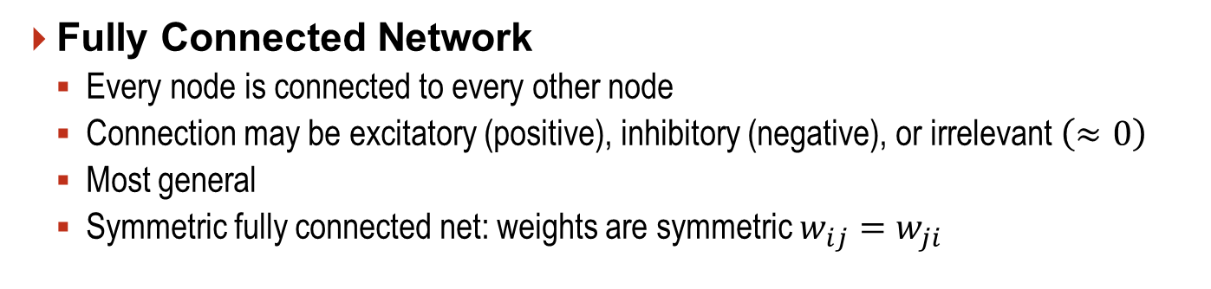
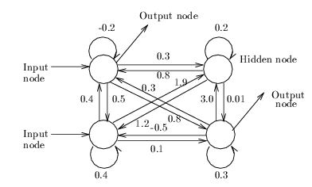
Fully Connected Network Architecture
Fully Connected Network
  Every node is connected to every other node
  Connection may be excitatory (positive), inhibitory (negative), or irrelevant $\left(≈0\right)$
  Most general
  Symmetric fully connected net: weights are symmetric $w_{ij}=w_{ji}$
Input Nodes: Receive inputs from environment
Output Nodes: Send signals to environment
Hidden Nodes: No direct interaction to the environment

Slide 26
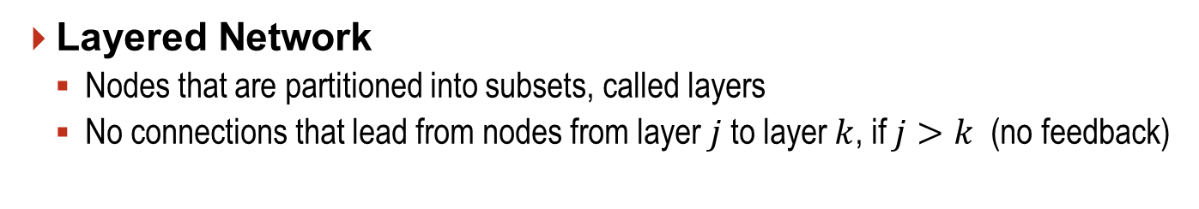
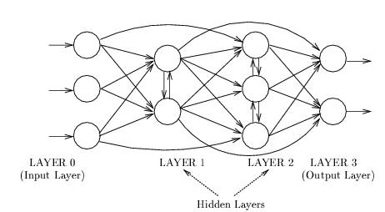
Layered Network Architecture
Layered Network
  Nodes that are partitioned into subsets, called layers
  No connections that lead from nodes from layer $j$ to layer $k$, if $j>k$ (no feedback)
Input from the environment are applied to input layer (layer 0)
Nodes in input layer are place holders with no computation occurring, i.e., their node functions are identity function

Slide 27
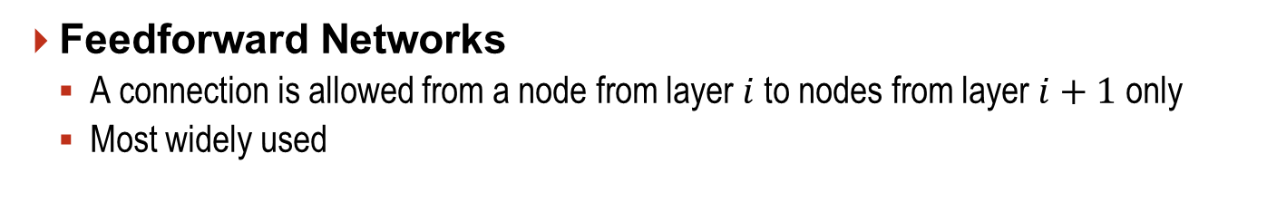
Feedforward Network Architecture
Feedforward Networks
  A connection is allowed from a node from layer $i$ to nodes from layer $i+1$ only
  Most widely used
Conceptually, nodes at higher levels successively abstract features from preceding layers

Slide 28
ANNs Learning and Training

Slide 29
Perceptron
Perceptron: A Learning neuron

Slide 30
Linear Separability
Linear Separability
  A set of (2D) patterns (x₁, x₂) of two classes is linearly separable if there exists a line on the (x₁, x₂) plane
    w₀ + w₁ x₁ + w₂ x₂ = 0
    Separates all patterns of one class from the other class
  A perceptron can be built with
    3 input x₀ = 1, x₁, x₂ with weights w₀, w₁, w₂

Slide 31

Linear Separability
Consider $b+w_{1}x_{1}+w_{2}x_{2}=0$
then
$$x_{2}=−\frac{w_{1}}{w_{2}}x_{1}−\frac{b}{w_{2}}$$
For a given line, there are many choices $w_{1},w_{2},and b$

Slide 32



Logical AND
Logical AND function, patterns (bipolar) decision boundary
  Decision line
  $w_{0}=−1 , w_{1}=w_{2}=1$
  $−1+x_{1}+x_{2}=0$
$$x_{2}$$
o
x
x1 | x2 | Output
-1 | -1 | -1
-1 | 1 | -1
1 | -1 | -1
1 | 1 | 1
$$x_{1}$$
o
o
X: Class I : output 1
O: Class II: output -1

Slide 33
Linear Inseparable

Slide 34
Perceptron Learning Rule
Any problem that can be represented by a perceptron can be learned by a learning rule
Theorem: The perceptron rule will always converge to weights which accomplish the desired classification, assuming such weights exist

Slide 35
Supervised Learning
Network is provided with a set of examples of proper network behavior, i.e., known inputs and targets
  {p₁, t₁}, {p₂, t₂},…, {p_{Q}, t_{Q}}
  p and t are inputs and corresponding correct (target) outputs

Slide 36
Reinforcement Learning
Similar to supervised learning
  Network is only provided with a score instead of correct target outputs
  Score is used to measure the performance over some sequence of inputs
  Less common than supervised learning
  More suitable in control systems

Slide 37
Unsupervised Learning
No target outputs are available
Only network inputs are available to the learning algorithm
  Weights and biases are updated in response to inputs
Networks learn to categorize or cluster the inputs into a finite number of classes

Slide 38
Hebb’s Postulate (1949)
“When an axon of cell A is near enough to excite a cell B and repeatedly or persistently takes part in firing it, some growth process or metabolic change takes place in one or both cells such that A’s efficiency, as one of the cells firing B, is increased”

Slide 39
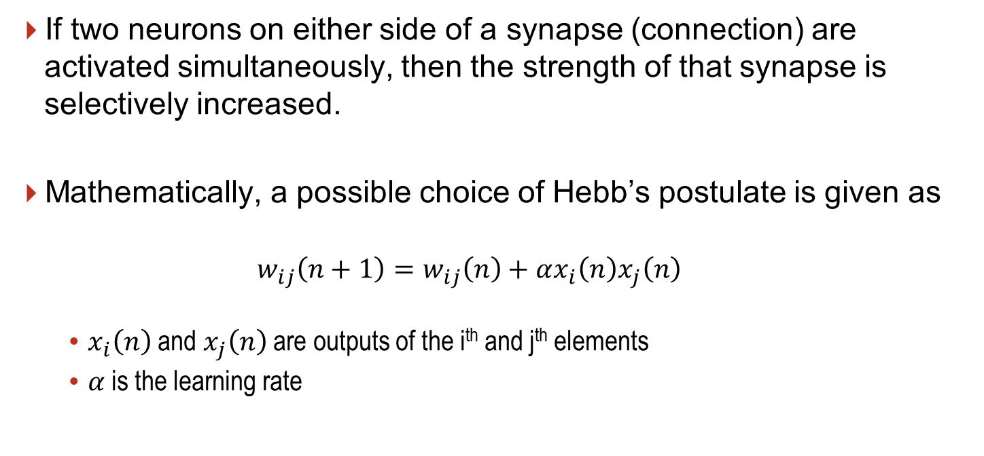
Hebb Rule
If two neurons on either side of a synapse (connection) are activated simultaneously, then the strength of that synapse is selectively increased.
Mathematically, a possible choice of Hebb’s postulate is given as
  $$w_{ij}\left(n+1\right)=w_{ij}\left(n\right)+αx_{i}\left(n\right)x_{j}\left(n\right)$$
    $x_{i}\left(n\right)$ and $x_{j}\left(n\right)$ are outputs of the i^{th} and j^{th} elements
    $α$ is the learning rate

Slide 40
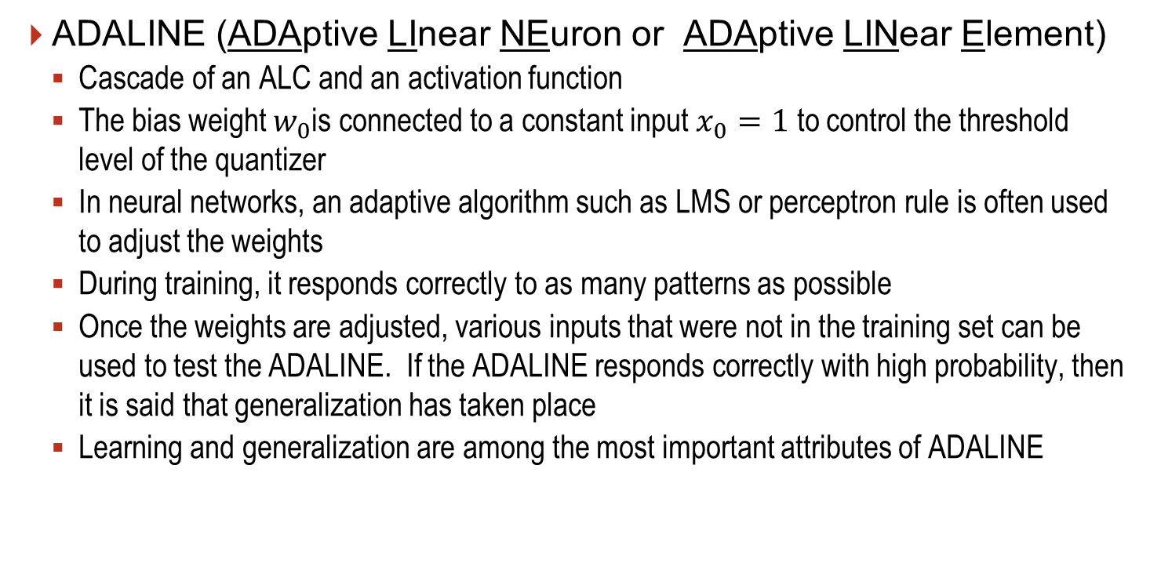
ADALINE
ADALINE (ADAptive LInear NEuron or ADAptive LINear Element)
  Cascade of an ALC and an activation function
  The bias weight $w_{0}$is connected to a constant input $x_{0}=1$ to control the threshold level of the quantizer
  In neural networks, an adaptive algorithm such as LMS or perceptron rule is often used to adjust the weights
  During training, it responds correctly to as many patterns as possible
  Once the weights are adjusted, various inputs that were not in the training set can be used to test the ADALINE. If the ADALINE responds correctly with high probability, then it is said that generalization has taken place
  Learning and generalization are among the most important attributes of ADALINE

Slide 41
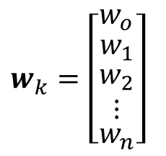

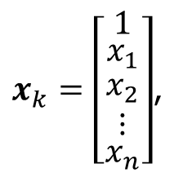

Adaptive Linear Combiner (ALC)
$x_{k}=\left[\begin{matrix}1 \\ \begin{matrix}x_{1} \\ \begin{matrix}x_{2} \\ ⋮\end{matrix}\end{matrix} \\ x_{n}\end{matrix}\right]$,
$$w_{k}=\left[\begin{matrix}w_{o} \\ \begin{matrix}w_{1} \\ \begin{matrix}w_{2} \\ ⋮\end{matrix}\end{matrix} \\ w_{n}\end{matrix}\right]$$
output
$$s_{k}=w_{k}^{T}x_{k}$$
error
$$∈_{k}=d_{k}−s_{k}$$

Slide 42
ADALINE
Source: Adaptive Switching Circuit, by Widrow and Hoff, 1960

Slide 43
ADALINE vs Perceptron
ADALINE network is very similar to a perceptron
They both suffer the same limitations: they can only solve linearly separable problems
ADALINE employs LMS learning rule, which is more powerful than the perceptron learning rule
  Perceptron learning rule is guaranteed to convergence that categorized to the training set. The resulting can be noise sensitive since patterns can lie closely to the decision boundaries
  LMS minimizes mean square error, therefore tries to move away from the decision boundaries as far from the training set as possible

Slide 44
Limitations
The perceptron learning rule of Rosenblatt and the LMS algorithm of Widrow-Hoff were design to train a single layer perceptron-like networks
  They are only to solve linearly separable classification problems
  Both Rosenblatt and Widrow were aware of the limitations. Both proposed multilayer networks to overcome them. However, they were NOT able to generalize their algorithms to train these powerful networks

Slide 45
The Back Propagation (BP) Algorithm
The first description of the backpropagation (BP) algorithm was contained in the thesis of Paul Werbos in 1974. However, the algorithm was presented in the context of general networks where neural networks as special case and was not disseminated in the neural networks community
It was not until the mid 1980s, the backpropagation was rediscovered and widely publicized
The multilayer perceptron, trained by the backpropagation algorithm, is currently the most widely used neural network.

Slide 46
The Back Propagation (BP) Algorithm
The backpropagation is the generalization of the LMS algorithm
Similar to the LMS learning, the backpropagation is an approximate steepest descent algorithm
  The performance index is the mean squared error
The difference between the LMS and the BP is only the way in which the derivatives are calculated

Slide 47
Multilayer Perceptron
Cascaded of perceptron networks
  The output of the first network is the input of the second network, and the output of the second network is the input of the third network, etc.
Each layer may have different number of neurons
  Also may have different activation function
  Same activation function in each layer

Slide 48
Function Approximation
We could use multilayer networks to approximate almost any functions
  If we have sufficient number of neurons in the hidden layer
It has been shown that ^{[1]} two layer networks, with sigmoid activation function in the hidden layer and a linear activation function in the output layer, we can approximate virtually any function of interest to any degree of accuracy, provided sufficiently many hidden neurons are available.
^{[1]} K.H. Hornik, et al, “Multilayer Feedforward Networks are Universal Approximators,” Neural Networks, vol. 2, no. 5, pp 359-366, 1989

Slide 49
Machine Learning

Slide 50
What is Machine Learning?
A model technique that involves data and figures out the model of data
An inductive approach
The model is the final product of machine learning
It addresses the concept of data, model, and it has nothing to do with learning
Learning is related to training data to solve the problem of finding the model
Machine Learning

Slide 51
Machine Learning
Machine learning process finds the model from the training data
Apply the model to the actual data
Applications: image recognition, speech recognition, and natural language processing, etc.
Apply Model to the Data

Slide 52
Challenges
Training Data and Actual Data Sometimes are very Distinct
Distinctness
  Distinctness of training and actual data is the fundamental challenge
  No machine learning approach can achieve the desired goal with wrong training data

Slide 53
Challenges
What is the number of neurons to use in a multi-layer network?
If the number of neurons is too large, the network will over fit the data
The complexity of the network is determined by the number of free parameters (weights and biases), which in turn is determined by the number of neurons
Goal is to adjust the complexity of the network to fit the complexity of the data

Slide 54
Generalization
A network trained to generalize will perform as well in a new situation as it does on the data on which it was trained
The network input-output mapping is accurate for the training data and for test data never seen before
The network interpolates well

Slide 55
Cause of Overfitting
Poor generalization is caused by using a network that is too complex (too many neurons/parameters)
To have the best performance we need to find the least complex network that can represent the data (Ockham’s razor)

Slide 56
Ockham’s Razor
Find the simplest model that explain the data

Slide 57
Overfitting Examples
Contains
some
errors
Fig. 1: Find a curve divides 2 groups
Fig. 2: A curve divides 2 groups
Fig. 3: Better Grouping, what cost?
Fig. 4: New input

Slide 58
Approaches
There are at least five approaches to produce a simple network
Growing: Start with no neurons in the network and then add neurons until the performance is adequate
Pruning: Start with large networks, which more likely overfit, and then remove neurons, one at a time, until the performance is degraded significantly
Global Searches: Such as the generic algorithm, search the space of all architecture networks to locate the simplest model that explains the data
Regularization and Early Stopping: Keep the network small by constrained the magnitude of the weights rather than constrained the number of network weights

Slide 59
Dealing with Overfitting
Regularization
  Construct the model structure as simple as possible
  Simplified model can avoid the effects of overfitting at a small performance cost
Validation
  A subset of the training data that is not used in the training process to monitor performance
Training Data

Slide 60
Validation Process
Divide the training data into 2 groups
  Training group and validation group
  Ratio 8:2
Train the model with the training set
Evaluate the performance of the model using the validation set
  If the model yields satisfactory performance, stop the training
  If does not yield satisfactory results, modify the model and repeat the training process

Slide 61
Types of Machine Learning
Classification is based on training method
  Supervised learning
    Input, correct output
    Applications: Classification and Regression
  Unsupervised learning
    Input
    Applications: Clustering
  Reinforcement learning
    Input, some output, grade for output
    Optimal interaction is required, e.g, control, or game play
Three Types of Machine Learning

Slide 62
Neural Networks and Machine Learning

Slide 63
Relationship
Relationship of Machine Learning and Neural Network
Neural Network is used to implement machine learning
Neural network is in place of the model in the machine learning
Learning rule is in place of machine learning

Slide 64
Case Studies

Slide 65
Machine Learning Papers
Machine Learning papers dominate MILCOM 2018 Conference
  There are 38 sessions 8 of which are Machine Learning sessions

Slide 66
Case Study #1
Hierarchical Modulation Classification using Deep Learning by

Slide 67
Introduction
29 Signals to classify
Method: Branch convolutional neural networks (B-CNN)
  Use filters to learn features of the modulations for the purpose of distinguishing between classes
  Each CNN can have several filters of fixed length which are convolved with the input signal and fed into the activation function to produce the output for the next stage
Activation function: Rectified linear unit (ReLU)
Keras framework
Results: Convolutional long short-term deep neural network (CLDNN) is found to outperform other architectures in modulation classification

Slide 68
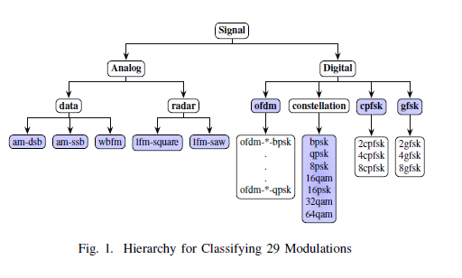
Signal Hierarchy
20 K samples
  1/3 training
  2/3 validation
29 signals to classify
SNR = [-20 18] dB

Slide 69
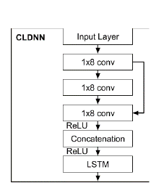
Convolutional Long Deep NN (CLDNN) Architecture
Approach:
  CLDNN
  Hierarchical classification
LSTM: Long Short-Term Memory
ReLU: Rectified Linear Unit

Slide 70
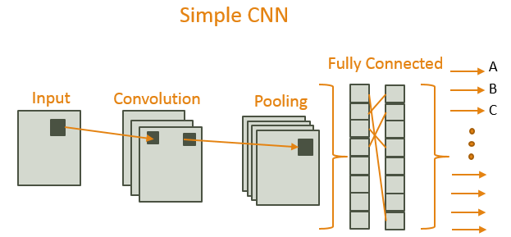
Example of a Simple Convolutional Neural Network
Filters
(Feature Extraction)
Data Reduction
(Max)

Slide 71
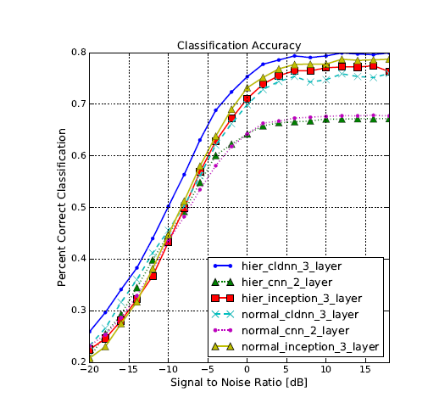
Hierarchical Classification Performance
Performance using trained data (1/3) * 20 K

Slide 72
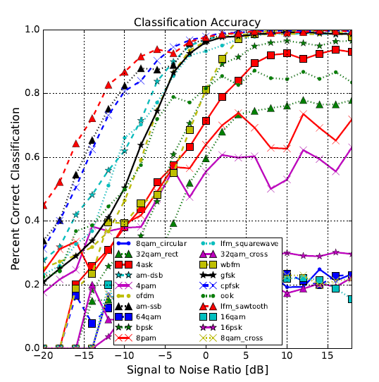
Modulation Classification Performance
Network cannot learn features of many modulations e.g. M-ary > 8, accuracy does not exceed 30%

Slide 73
Case Study #2
Diabetes Prediction on Pima Indian Diabetes https://www.andreagrandi.it/2018/04/14/machine-learning-pima-indians-diabetes/

Slide 74
Introduction
The Pima are group of Native Americans living in Arizona. A genetic predisposition allowed this group to survive normally to a diet poor of carbohydrates for years. In the recent years, because of a sudden shift from traditional agricultural crops to processed foods, together with a decline in physical activity, made them develop the highest prevalence of type 2 diabetes and for this reason they have been subject of many studies.
The Pima Indian Diabetes dataset was obtained from the UCI machine learning repository. The binary response variable holds the value ‘0’ or ‘1’, where ‘0’ being diabetes test negative and ‘1’ meaning the test is positive and the patient is diagnosed with diabetes. Class ‘1’ consists of 268 cases i.e. 34.9% and class ‘0’ consists of 500 cases i.e. 65.1%.

Slide 75
Data Set
768 women with eight different attributes
  Number of times pregnant
  Plasma glucose concentration a 2 hrs in an oral glucose tolerance test
  Diastolic blood pressure (mm Hg)
  Triceps skin fold thickness (mm)
  2-hr serum insulin (mu U/ml)
  Body mass index (weight in kg/ (height in m)^2)
  Diabetes pedigree function
  Age (years)
Supervised learning

Slide 76
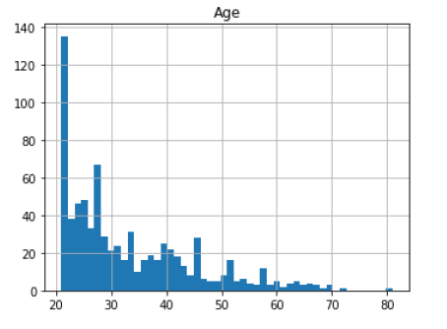
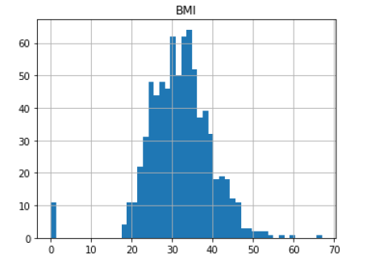
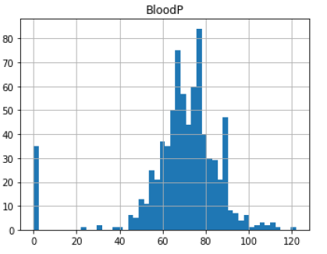
Visual Data (1 of 3)
Diastolic Blood Pressure

Slide 77
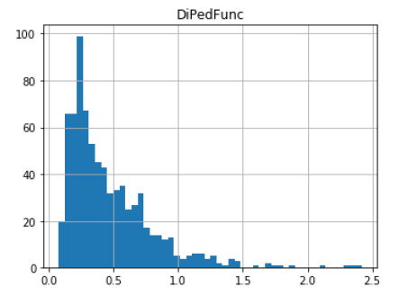
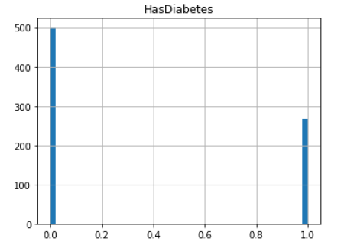
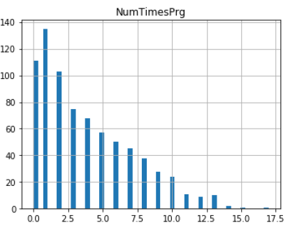
Visual Data (2 of 3)
Diabetes Pedigree Fn.

Slide 78
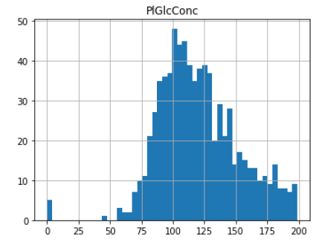
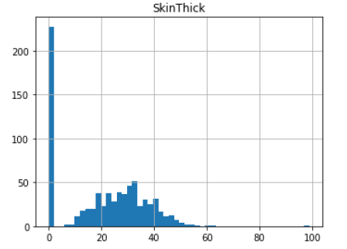
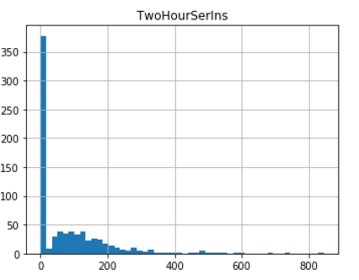
Visual Data (3 of 3)
Plasma glucose

Slide 79
Next Steps
SVC (Support Vector Clustering) outperforms numerous algorithms
Find the best parameters for SVC
Apply the parameters to the model and train it
Make prediction
The final score of 76% using the SVC

Slide 80


Slide 81
References
[1] Elements of Artificial Neural Networks, by Mehrotra, Mohan, and Ranka, MIT Press 1997.
[2] Principles of Artificial Neural Networks, by Daniel Groupe, World Scientific 2013.
[3] Fundamental of Neural Networks Architectures, Algorithms, and Application, by Laurene Fausett, Pearson 1993.
[4] MATLAB Deep Learning with Machine Learning, Neural Networks and Artificial Intelligent, by Phil Kim, Apress 2017.

Slide 82
Machine Learning Tools
Open Source Frameworks
  Keras
  R
  TensorFlow
  Theano
  Caffe
  Torch
Microsoft:
  CNTK: https://blogs.microsoft.com/ai/microsoft-releases-cntk-its-open-source-deep-learning-toolkit-on-github/#sm.000008k0wuiqi5fedv9smfnn85lc9
Scikit-learn: Machine learning in Python:
  https://scikit-learn.org/stable/
Amazon: https://aws.amazon.com/training/learning-paths/machine-learning/?tag=zdnet-vig-20
MATLAB toolboxes

